Slide 1


Minimizing Residual Velocities With Euler Pole Parameters Binational Geospatial Software Developers Summit - 2025
Presented by: Mohammad Ali Goudarzi (CGS) Rick Bennett (NGS)
April 23, 2025

Slide 2
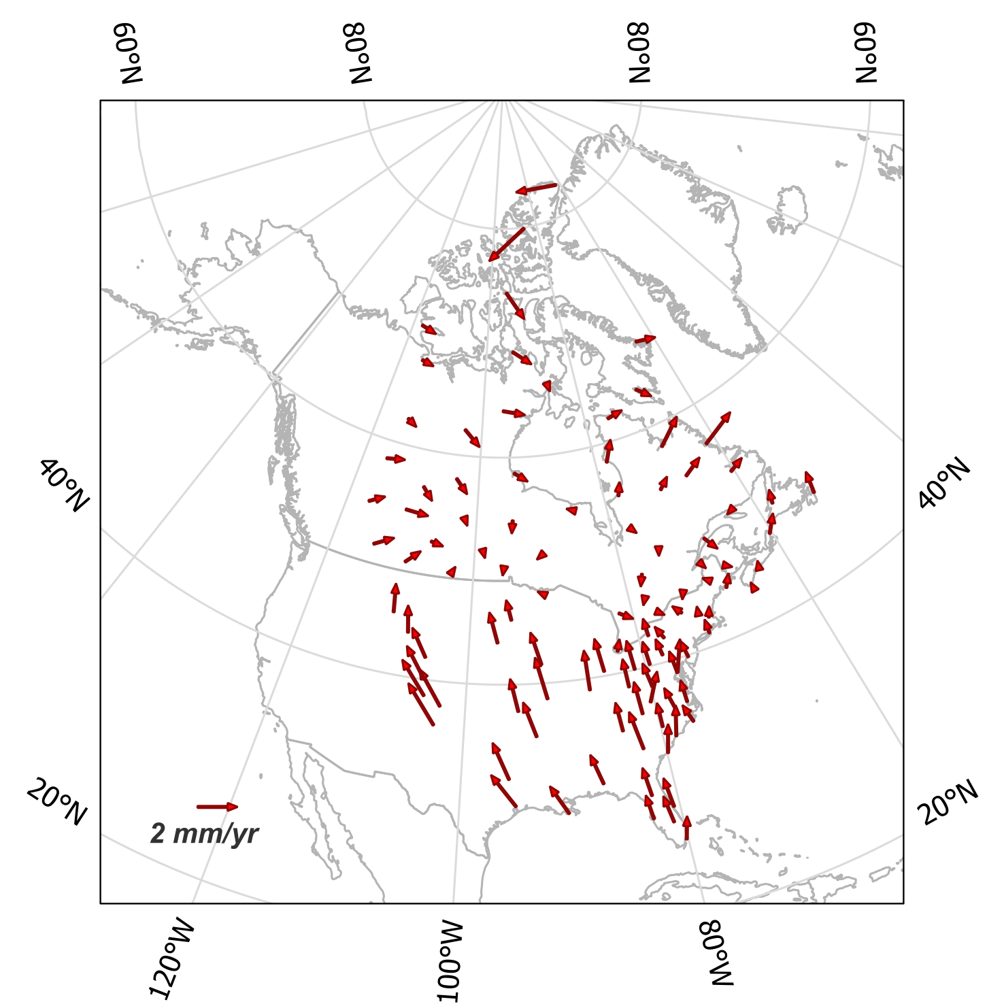
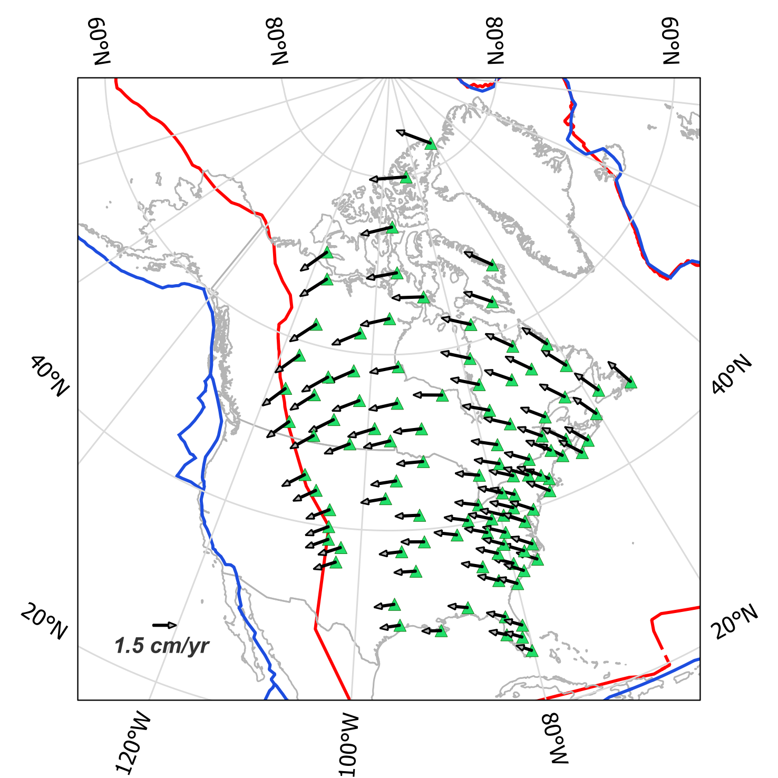
NATRF2022 and the role of EPPs
NATRF2022 is a plate-fixed yet geocentric reference frame that moves with the stable part of the NA plate, therefore minimizes the change in coordinates.
EPPs, as a defining part of the NSRS and CSRS, will minimize the intraplate velocities.
Notes:
“NATRF2022 coords ≈ ITRF coords rotated to the NA plate and then corrected for deformation”

Slide 3
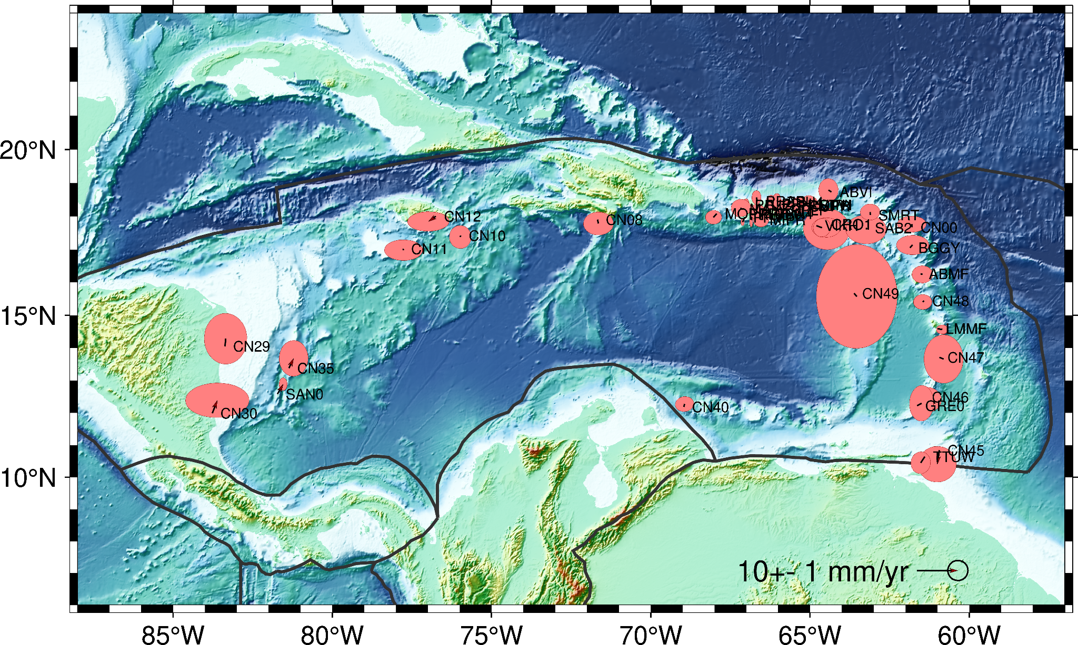
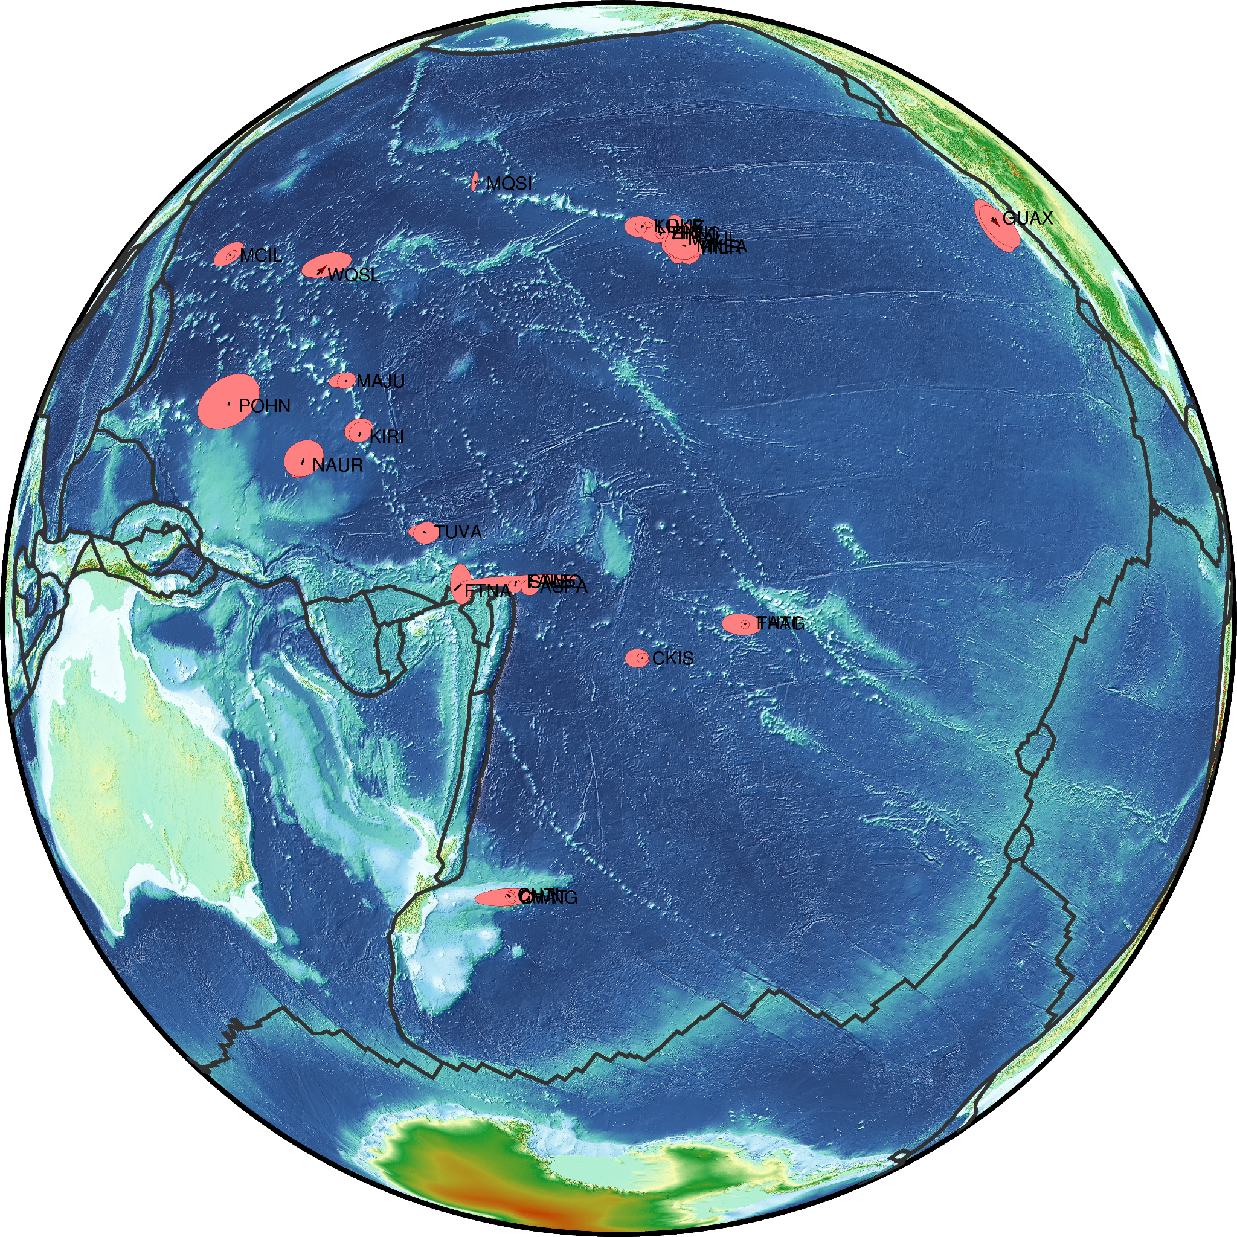
The role of EPPs in other plates
NA
CATRF2022
PATRF2022
CA
SA
CO
(N/P/C/M)ATRF2022 coords = ITRF coords rotated to the NA/PA/CA/MA plate using EPPs + Corrections for intraframe deformations (only for CGS)
Notes:
NATRF2022 coords ≈ ITRF coords rotated to the NA plate and then corrected for deformation
EPPs are also used to minimize the residual motion of the Caribbean, Pacific and Marianas plates.

Slide 4
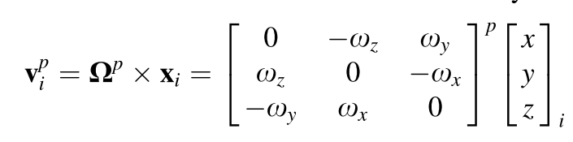
How they were calculated
NAEPP2022 estimated:
based on the spherical model of Earth,
using the latest velocities: version 8 from CGS and MYCS3.0 from NGS (both referenced to the ITRF2020),
with stations meeting the following criteria:
located in the stable interior part of the NA plate,
far enough from plate boundaries, substantial seismicity, and intraplate deformation zones,
having stable monuments, preferably anchored to bedrock, and
having a minimum of 2 years observation period.
Euler pole theorem:

Slide 5
Other considerations
Effect of the glacial isostatic adjustment (GIA).
Velocity transformation from Geodetic to spherical coordinates system.
Changes in ellipsoidal heights.
Accuracy of the propagated coordinates.
r1 value recommended by IUGG for GRS80 was used for Earth’s mean radius.
The EPC Software (DOI: 10.1007/s10291-013-0354-4) was used for numerical calculations and analysis.
Notes:
Indicate what was found

Slide 6
The EPP Values
Parameter | NATRF2022 | PATRF2022 | CATRF2022 | MATRF2022
Latitude(°) | -3.8205 | -62.511 | 30.803 | 12.1432
Longitude(°) | -86.2977 | 111.0382 | -91.273 | 143.7228
Magnitude(mas/yr) | 0.7075 | 2.467 | 1.202 | 10.264
ω_{x} (mas/yr) | 0.046 | -0.409 | -0.056 | -8.089
ω_{y} (mas/yr) | -0.704 | 1.063 | -0.957 | 5.937
ω_{z} (mas/yr) | -0.047 | -2.188 | 0.589 | 2.159
Reference epoch(t₀): 2020.0
EPP values are adopted by convention (after extensive analyses). Therefore, no uncertainties are assigned to them.

Slide 7
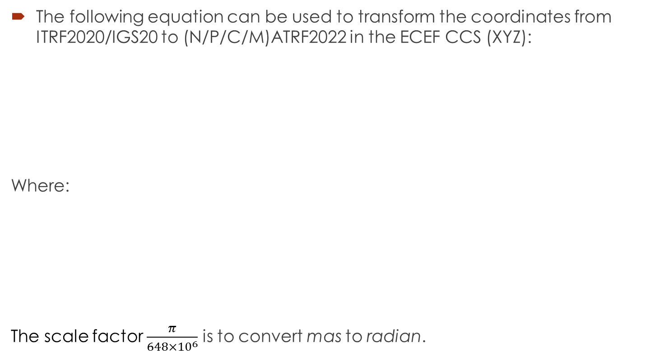
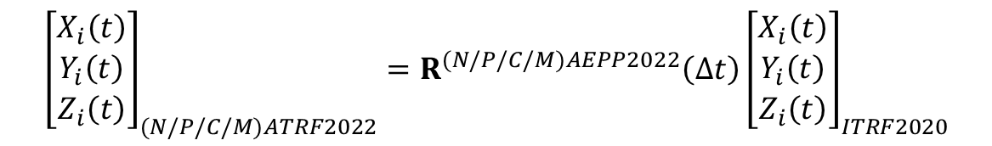


From ITRF2020/IGS20 to NATRF2022

Slide 8
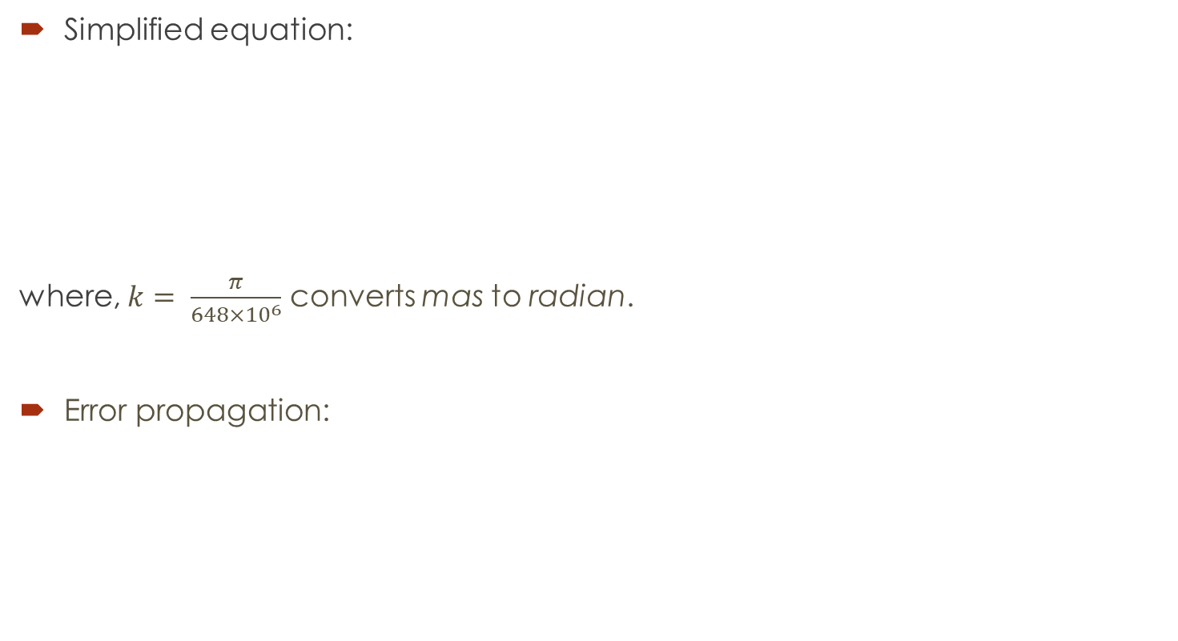
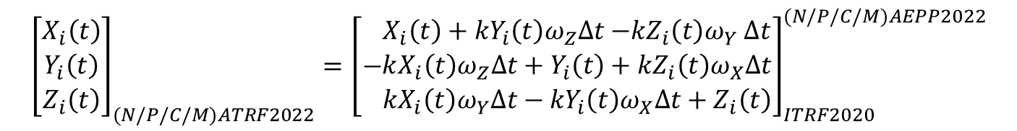
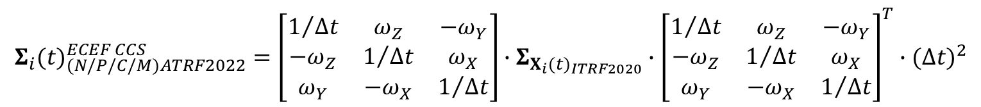
From ITRF2020/IGS20 to NATRF2022

Slide 9

From other RF to NATRF2022
There are some tools already available to convert from many reference frames, specially NAD83, to NATRF2022:
In Canada:
TRX desktop version
TRX online version (https://webapp.csrs-scrs.nrcan-rncan.gc.ca/geod/tools-outils/trx.php)
In the US:
NCAT (NGS Coordinate Conversion and Transformation Tool) (https://www.ngs.noaa.gov/NCAT/)
A dedicated session on this topic has been scheduled for tomorrow.

Slide 10
Thank you!
Ali Goudarzi (mohammadali.goudarzi@nrcan-rncan.gc.ca)
Rick Bennett (rick.bennett@noaa.gov)

